Slide 1

SEN Information Report

Slide 2
At Gaddesden Row Primary School we…
Aim to include all pupils in every aspect of school life
Work hard to meet the individual needs of each pupil, and to make adjustments to all aspects of our provision as necessary to ensure that every pupil succeeds
Recognise that a child has SEND, if they have a learning difficulty or disability which calls for special educational provisions to be made for him or her

Slide 3
Introduction
This SEN Information Report serves as an information source for all parents but especially parents of children who have, or may have, needs in school, which are different to those of their peers.
All Hertfordshire Local Authority (LA) maintained schools have a similar approach to meeting the needs of pupils with Special Educational Needs (SEN) and are supported by the LA to ensure that all pupils, regardless of their specific needs, make the best possible progress in school.
All SEN provision delivered to children has regard for the Special Educational Needs Code of Practice 2014 and the school’s SEN policy.
Our SEN information report complies with:
Section 69(2) of the Children and Families Act 2014
Regulation 51 of the Special Educational Needs and Disability Regulations 2014

Slide 4
Contents
Special Education Needs- Four key areas
How does Gaddesden Row JMI School know if children need extra help and what should I do if I think my child may have Special Educational Needs?
How will staff support my child?
How will the SENCO support my child?
How will I know how my child is doing?
How will the learning and development of provision be matched to my child’s needs?
What support will there be for my child’s overall well-being?
      Please click on the section to be taken directly to that page

Slide 5
Contents (continued)
What specialist services and expertise are available at or accessed by the school?
What training have the staff, supporting children and young people with SEND, had or having?
How will you support my child’s learning?
How will I be involved in discussions about planning for my child’s education?
How will my child be included in activities outside of the classroom including school trips?
How accessible is the school environment?
Who can I contact for further information?
      Please click on the section to be taken directly to that page

Slide 6
Contents (continued)
How will the school prepare and support my child to join the school, transfer to a new school or next stage of education and life?
How are the school’s resources allocated and matched to children’s special educational needs?
How is the decision made about how much support my child will receive?
How can I find information about the local authority’s Local Offer of services and provisions for children and young people with special educational needs and disability?
      Please click on the section to be taken directly to that page

Slide 7




Special Education Needs are broadly grouped into the following categories
Communication and Interaction
Cognition and Learning
Social, Emotional and Mental Health (SEMH)
Sensory, and/or Physical Needs
(please click on each category for a more detailed explanation or see Chapter 6, paragraph 6.28 of The Special Educational Needs Code of Practice)

Slide 8
How does Gaddesden Row JMI School know if children need extra help and what should I do if I think my child may have Special Educational Needs?
If you are worried about your child, you should:
First speak to your child’s class teacher-please make an appointment via the school office. This will give you the time and space you need to discuss your child.
Alternatively, email Mrs Scott ,the school Special Needs Co-ordinator (SENCO) at kscott@gaddesdenrow.herts.sch.uk
Or phone us on 01582840376

Slide 9
How does Gaddesden Row JMI School know if children need extra help and what should I do if I think my child may have Special Educational Needs?
If a child joins Gaddesden Row from Reception, the EYFS staff complete a home visit. This is a good opportunity for parents to raise any concerns they may have before their child starts school.
Information is gained from previous educational settings when a child enters our school. This is obtained through reports and documents and discussions with the school’s SENCo.

Slide 10
How does Gaddesden Row JMI School know if children need extra help and what should I do if I think my child may have Special Educational Needs?
Teachers continuously assess pupils’ progress through daily observations, marking and feedback.
Achievements are tracked using a variety of tools that enable teachers to check that pupils are making progress, in line with expectations for their age.
Each term, teachers make formal judgments of pupils’ achievements.
The progress of all pupils is then discussed with the Headteacher and SENCO every term to discuss progress and barriers to learning.
Between these discussions, staff may bring concerns to the SENCO and/or Head Teacher.
There is a graduated response to the identification and assessment of children falling behind age related expectations (ARE)

Slide 11
How does Gaddesden Row JMI School know if children need extra help and what should I do if I think my child may have Special Educational Needs?
Pupil voice is key in helping children with SEND needs, therefore the pupils views are always taken into consideration.
Children have opportunities to articulate concerns or anxieties about their own learning. Children are taught to self-assess their own learning and enter into reflective conversations with teachers about their progress.

Slide 12
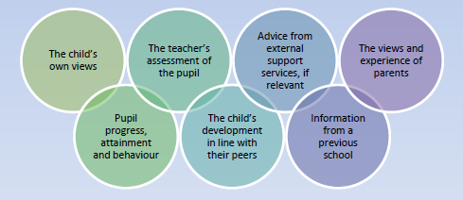
How does Gaddesden Row JMI School know if children need extra help and what should I do if I think my child may have Special Educational Needs?
Before identifying a child as needed SEND Support, the class teacher and SENCO, will establish a clear analysis of the pupil’s needs drawing on the following:

Slide 13
How will staff support my child?
Teachers are responsible for the learning and progress of all the children in their class.
The school strongly prioritises the provision of high quality, whole class teaching. This is the first and most important provision for all children, no amount of intervention and specialist support can compensate if this provision is not right.
Leaders closely monitor the quality of provision and provide support, advice and training for teachers and learning support assistants.
Children’s needs are supported by high ratios of adults to pupils in every class.

Slide 14
How will staff support my child?
Using our graduated approach, in the form of a four-part cycle of assess, plan, do and review, decisions and actions are made, revisited, refined and revised.
Children’s strengths are celebrated and used as a basis for learning.
The governing body also monitor the progress of children receiving special educational provision. Termly progress information is provided to the governors from the SENCo and there is a governor specifically assigned to monitor SEN.

Slide 15
How will the SENCO support my child?
The SENCO oversees and co-ordinates all special education provisions. This happens through:
termly pupil progress meetings
SEN support reviews
discussions about SEND provision,
monitoring and evaluating provision
sharing best practice.
The SENCO also ensures that appropriate external professionals are involved in planning provision. These external professionals may include:
Educational Psychologist (EP)
Speech and Language Therapist (SaLT)
Occupational Therapist (OT)
Advisory Teacher (Autism, Learning difficulties)

Slide 16
How will I know how my child is doing?
How your child is doing is an ongoing conversation between parents, carers and school staff.
You will be able to speak to your child’s class teacher on formal occasions through ‘parents evening’.
During ‘parents evening’ you will be provided with an overview of your child’s curriculum achievements.
Assess, Plan, Do, Review meeting with the SENCo
You will be provided with a written report in July.
Education, Health and Care plan initial meeting and reviews, when appropriate.
Informal opportunities to talk to teachers, Head Teacher, SENCO and other staff arise throughout the week, as all teachers and the Headship team are in the playground often.

Slide 17
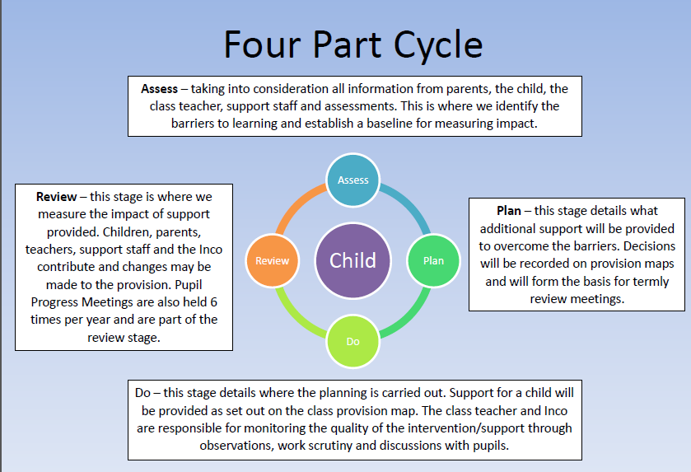
How will the learning and development of provision be matched to my child’s needs?
For children receiving SEND support the class teacher will use the four-part cycle to ‘Assess, Plan, Do and Review’ children’s special educational needs. This process enables staff to monitor the provision, support and progress of the pupil.
There are termly planning meetings for children receiving special educational provisions.
These involve the parents, SENCO and class teachers.
Notes:
17

Slide 18
How will the learning and development of provision be matched to my child’s needs?
On daily basis:
Teachers assess the learning of all the pupils, and adjust their subsequent teaching accordingly.
Children’s needs are met by careful differentiation e.g.
adjusting teaching and learning styles
structure of the lesson
the resources provided
the layout of the classroom
the pitch of the activities
support from adults
pre-teaching of vocabulary and concepts
Support from peers
sensory breaks
IT
Visual support

Slide 19
What support will there be for my child’s overall well-being?
The nature of Gaddesden Row allows the school to always support the emotional and social development of all pupils.
We work hard to develop children as well-rounded, happy, confident people.
The school has a zero tolerance of bullying.
The school has a policy on supporting pupils with medical conditions and has a successful history of working with pupils who require specialist medical care
All staff receive annual safeguarding refresher training and a Child Protection Lead and Deputy Lead who deal with child-protection cases.

Slide 20
We ensure children feel safe by having strong, clear routines,
consistent expectations and consistent adults in class.
We teach children to respect each other and their environment.
We refer children to external service if needed, such as CAMHS (Child and Adolescent Mental Health Services)
We have qualified paediatric first aiders on our staff.
Individual Healthcare plans are written with parents where needed.
E-safety lessons are taught and referred to on a regular basis.

Slide 21
What specialist services and expertise are available at or accessed by the school?
Best practice locally is shared through networks such as the Head Teachers’ Consortium, Deputy Head Teachers’ Network and local SENCo meetings
Specialist services are triggered when the school and child have worked through the Assess, Plan, Do and Review cycle. Once additional support has been put in place, the progress of the child is assessed. If staff members feel that limited progress is made, outside agencies will be contacted to offer further advice and support.

Slide 22
What specialist services and expertise are available at or accessed by the school?
Other services the school can access include:
Speech and Language Unit,
Occupational Therapy,
Physiotherapy, Schools Counselling Service,
Early Years Advisory Teacher,
Communication Disorders Team (ASD),
Educational Psychologist,
Dacorum Education Support Centre (DESC),
Physical and Neurological Impairment Team,
School family worker and Healthcare teams including: school nurse, CAMHS, paediatricians and GPs. .

Slide 23
What training have the staff, supporting children and young people with SEND, had or having?
All staff receive regular training in providing high quality teaching, including differentiating for children with additional needs.
All teaching and learning staff in the school support children with special educational needs. We believe strongly in an inclusive education, and ensure that all children have access to all opportunities in school.
We have a team of good and outstanding teachers, who continually work together to improve their teaching practice.
All staff have completed the Trauma and Attachment training.
The SENCo provides training for staff members when an area of need is identified in the classroom

Slide 24
How will you support my child’s learning?
Your role as your child’s parent is central to their education. We value your knowledge and expertise about your child, and strongly believe that we are here to support not only your child but also the family.
We conduct home visits for all Reception children before their first day of school, so that the child’s education starts with the school and parents working together.
The school provides opportunities to explain to parents how their child’s learning is planned and advice is given on how to best support outside of the school.
Where appropriate, parent training or learning events are provided.
During SEN meetings the SENCO and class teacher will inform parents about strategies and resources that their child is using to support their targets.

Slide 25
How will I be involved in discussions about and planning my child’s education?
Parents are involved in every stage of their child’s education.
Communication between school and parents/carers is an integral part of our school ethos.
Parents/carers are invited to meet with the teacher virtually before a support plan is created to discuss their child’s needs and to be involved with target setting.
Review meetings will be held termly to discuss current targets and if appropriate, set new ones.
Parents also have a broader role in the school through the governing body. A governor is specifically assigned to SEN and is involved with the review of the SEN policy.

Slide 26
How will my child be included in activities outside of the classroom including school trips?
All pupils, regardless of their additional need, are included in all school activities and offsite visits.
Parents and pupils are involved in the planning of activities and trips in order to ensure all pupils can participate in all aspects of school life.
Where appropriate, 1:1 or additional adult support may be provided.
Risk assessments are conducted in order to remove any barriers to participation.

Slide 27
How accessible is the school environment?
The school is accessible to all. Although some of the school is housed in a building built in the 1800s, which can pose some difficulties when considering access, we have accessible routes to all classrooms and offices.
There is a disabled toilet located in the main body of the school.
All classrooms have a quiet area, usually the book corner.
Classrooms have low ceilings which help acoustics to improve hearing for all children but specifically for pupils with hearing difficulties.
For children and parents with limited English, we provide translators for formal meetings and the website can be translated into different languages
There are only a small number of steps around the school site.

Slide 28
Who can I contact for further information?
The school office is open throughout the day, and office staff can direct enquires to the most appropriate member of staff.
The school has a clear complaints procedure available to download on the school’s website or the school office..
Contact | Position
Mr Merriman | Head Teacher/DSP | head@gaddesdenrow.herts.sch.uk
Mrs Scott | SENCO/ DSP | kscott@gaddesdenrow.herts.sch.uk
Mrs McCormick | School Secretary | admin@gaddesdenrow.herts.sch.uk

Slide 29
How will the school prepare and support my child to join the school, transfer to a new school or next stage of education and life?
Children entering the mainstream school will have a tour of the school with their parents and Head Teacher
After that the point of contact will be the class teacher and SENCO
Entering Early Years Foundation Stage: New to Reception meeting during the summer term before they start
We seek information from the preceding school and work closely worth the parents to ensure that the child’s needs are met quickly.
SENCo and class teachers to liaise with next setting when a pupil leaves the school to ensure a thorough transition.
Transition meetings between class teachers and key stages. When class teachers are changing.
Where appropriate, extra visits to a child’s secondary school are arranged.
All pupils benefit from a transition programme in the summer term to prepare them for their next year group.
SENCo liaises with all members of staff to ensure a smooth transition between classes/key stages

Slide 30
How are the school’s resources allocated and matched to children’s special educational needs?
The school has an amount identified in its overall budget that related specifically to SEN. This is used for resources to support the progress of children with SEN.
Pupil progress meetings and SEN support reviews lead the planning for the allocation of the school’s resources in order to ensure children’s needs are best met with what is available.
The governing body receives regular reports on how the school budget is being spent and the allocation of all resources
The experience, training and expertise of Teaching Assistants are carefully matched to the needs of the children.

Slide 31
How are the school’s resources allocated and matched to children’s special educational needs?
Exceptional Needs Funding
This is money given to schools and childcare providers to help them support children with the most complex and exceptional needs.
Schools and childcare providers have to apply for the exceptional needs funding. Speak to your childcare provider or school SENCO to discuss getting the funding to help your child's day to day life while in education.
How it works
There are groups of teachers and SEN professionals who meet to decide if the child's needs meet the criteria – this is called an Exceptional Needs Panel.
The panel meets to decide who gets the funding.
Payments are made termly.
Funding stops when the child leaves education.

Slide 32
How is the decision made about how much support my child will receive?
Support is carefully matched to children’s needs
Support can be give through:
  Adjustments to the curriculum
  Intervention groups
  One-to-one
  Small group work
  Specialist resources
Decisions are made through careful assessment, analysis of pupil’s progress, SEN support discussions and observations of the child
It is our aim to develop the independence of all pupils and very few children will receive full-time support from the same staff.
Some children with exceptional needs receive specific funding for specialist equipment or support that cannot be supplied through what is normally available in school.

Slide 33


How can I find information about the local authority’s Local Offer of services and provisions for children and young people with special educational needs and disability?
Hertfordshire's SEND Local Offer is your one-stop shop for information, support, services and activities available for children and young people with special educational needs, and their families.
The Local Offer has been created by parents and professionals.
https://www.hertfordshire.gov.uk/microsites/local-offer/the-hertfordshire-local-offer.aspx
DSPL is a Hertfordshire-wide partnership approach where parents, staff in early years settings and schools, further education colleges, local authority officers and representatives from other agencies, work together as part of an Area Group, reviewing and developing the range of provision and support services available to their local community
http://www.dacorumdspl.org.uk/

Slide 34

A message from our SENCO
Thank you for taking the time to read our SEN Information Report. I hope that you have found the PowerPoint informative and accessible. However; if you do require any further information or clarification please do not hesitate to contact me personally at kscott@gaddesdenrow.herts.sch.uk
Kindest regards
Kelli-Marie Scott
SENCO

Slide 35

Glossary

Slide 36
Communication and Interaction
Children and young people with SEN may have difficulties in one or more of the areas of speech, language and communication.
They may find it more difficult to communicate with others.
They may have problems taking part in conversations, either because they find it difficult to understand what others say or because they have difficulties with fluency and forming sounds, words and sentences.
It may be that when they hear or see a word they are not able to understand its meaning, leading to words being used incorrectly in or out of context and the child having a smaller vocabulary.
For some children and young people, difficulties may become increasingly apparent as the language they need to understand and use becomes more complex. routines or have difficulties with their co-ordination and fine-motor functions.

Slide 37
Cognition and Learning
Where children and young people learn at a slower pace than others their age, they may:
have difficulty in understanding parts of the curriculum
have difficulties with organisation and memory skills
have a specific difficulty affecting one particular part of their learning such as in literacy or numeracy
The term ‘learning difficulties’ covers a wide range of needs, including moderate learning difficulties (MLD), severe learning difficulties (SLD) and profound and multiple difficulties (PMLD). Specific learning difficulties (SpLD) such as dyslexia, dyspraxia and dyscalculia come under this term.

Slide 38
Social, Emotional and Mental Health
Children and young people may experience a wide range of social and emotional difficulties which present themselves in many ways. They may:
have difficulty in managing their relationships with other people
be withdrawn
behave in ways that may hinder their and other children’s learning or that have an impact on their health and wellbeing
This broad area includes attention deficit disorder (ADD), attention deficit hyperactivity disorder (ADHD) or attachment disorder. It also includes behaviours that may reflect underlying mental health difficulties such as anxiety, depression, self-harming and eating disorders.

Slide 39
Sensory, and/or Physical Needs
Children and young people may experience a wide range of social and emotional difficulties which present themselves in many ways. They may:
have difficulty in managing their relationships with other people
be withdrawn
behave in ways that may hinder their and other children’s learning or that have an impact on their health and wellbeing
This broad area includes attention deficit disorder (ADD), attention deficit hyperactivity disorder (ADHD) or attachment disorder. It also includes behaviours that may reflect underlying mental health difficulties such as anxiety, depression, self-harming and eating disorders.

Slide 40
Graduated Response/Approach

